Slide 1
Descriptive statistics
GEOG4300 /6300: Intro to data science
Prof. Jerry Shannon

Slide 2
Things to be aware of
Lab 0 is due Friday September 4

Slide 3
Which measure of central tendency should we use for the number of UGA football games we have attended? (And how should we wrangle this data before doing so?)
32 | 0 | 12
0 | 0 (for now!) | 1
18 | 0 | 4
1 | 0 | 4
0 | 0 | 6
4 | 0 | 1
0 | 1 | 0
1 | 15 | I have attended approximately 18 UGA football games.
8 | 1 | 0
0 | None | 9 Football Games

Slide 4
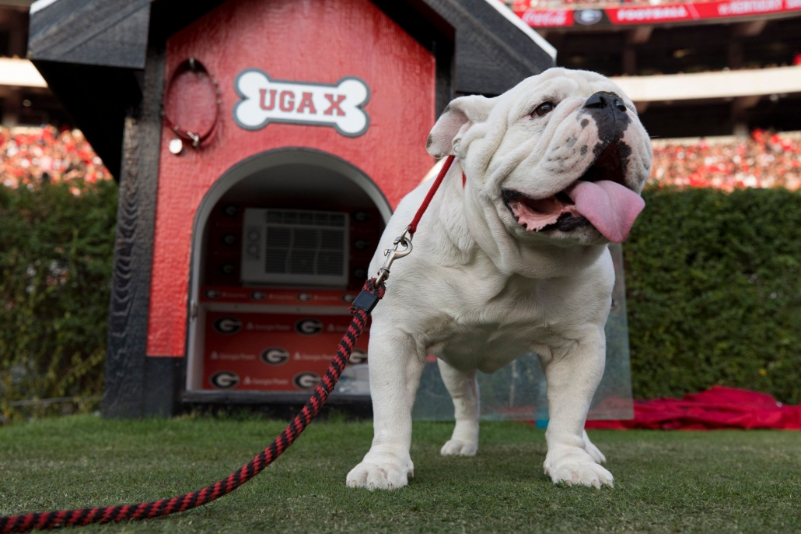
What’s a related question we could ask for which mode would be the appropriate measure of central tendency?

Slide 5
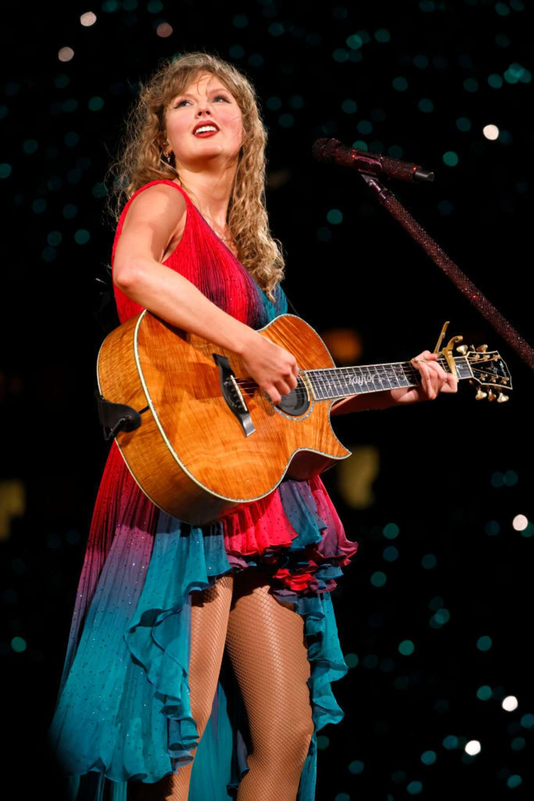
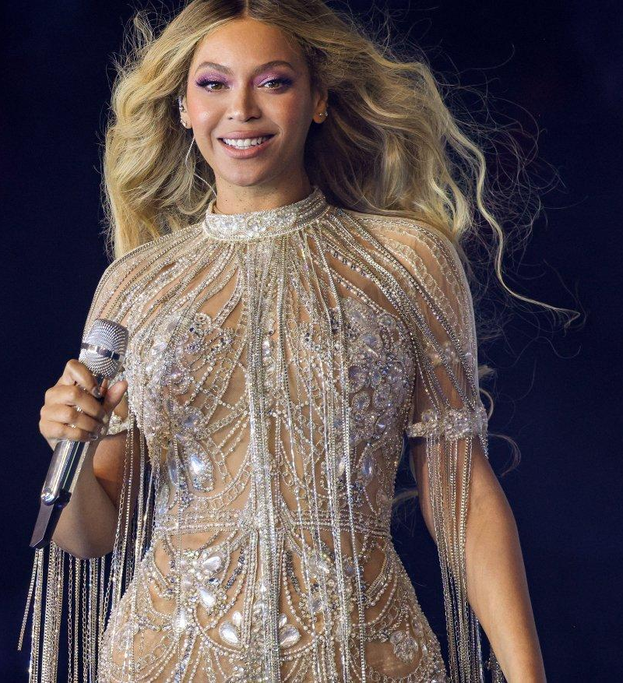
Try it out!
Load our “swift_beyonce_spotify” dataset into Excel/Google Sheets. This gives data on all songs by Taylor Swift and Beyonce from Spotify.
Calculate the appropriate measure of central tendency for each artist for the following variables:
Danceability
Loudness
Time_sign (Time signature)
Duration_ms (Length in milliseconds)
Functions to use: =AVERAGE(), =MEDIAN, =MODE()

Slide 6
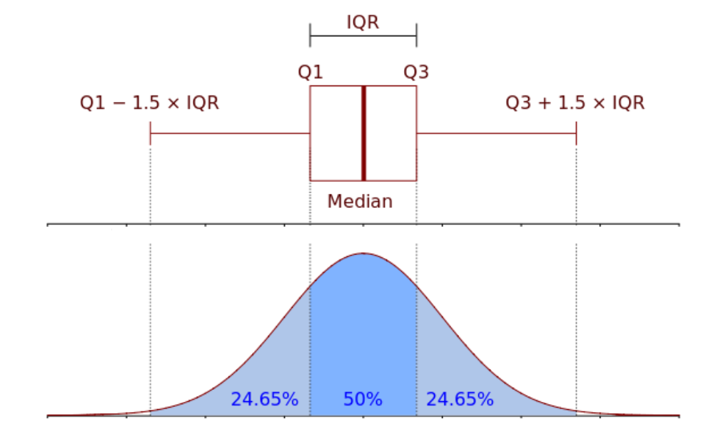
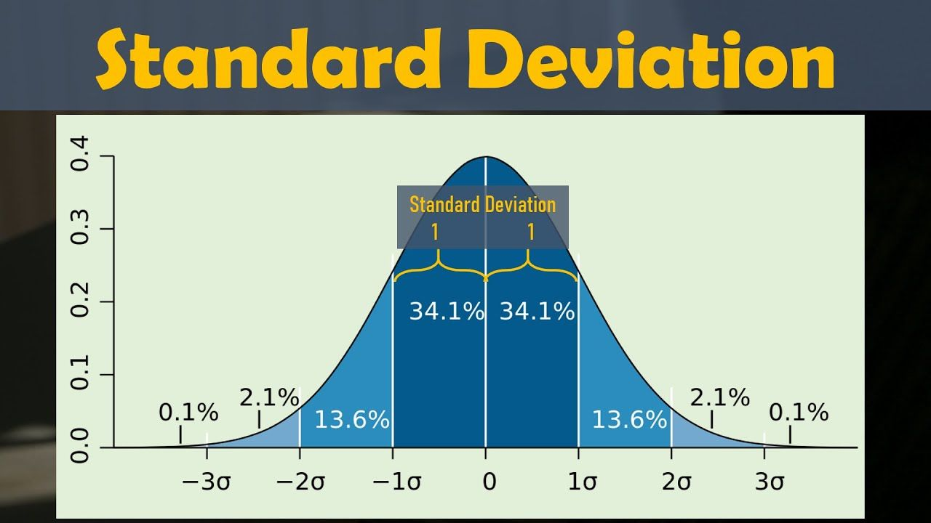
Standard deviation and IQR
What’s the difference?

Slide 7
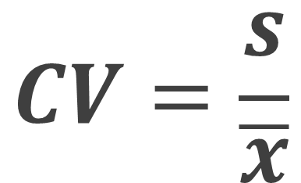
Coefficient of variation
Standard deviation divided by the mean
Useful when means vary across groups or measures
$$CV=\frac{s}{\overline{x}}$$

Slide 8
R challenge!
Load the Swift/Beyonce dataset into R
You can use the sd() and IQR() to calculate the distribution of danceability, loudness, and duration.
How would you interpret each result in plain English?
Which is the better measure for each variable?

